Slide 1


Do the Dependency Conflicts in My Project Matter?
2
1
2
1
Ying Wang, Ming Wen, Zhenwei Liu, Rongxin Wu, Rui Wang, Bo Yang, Hai Yu, Zhiliang Zhu and Shing-Chi Cheung
1
1
1
1*
2*
Northeastern University
The Hong Kong University of Science and Technology
Ying Wang
2019-1-11

Slide 2
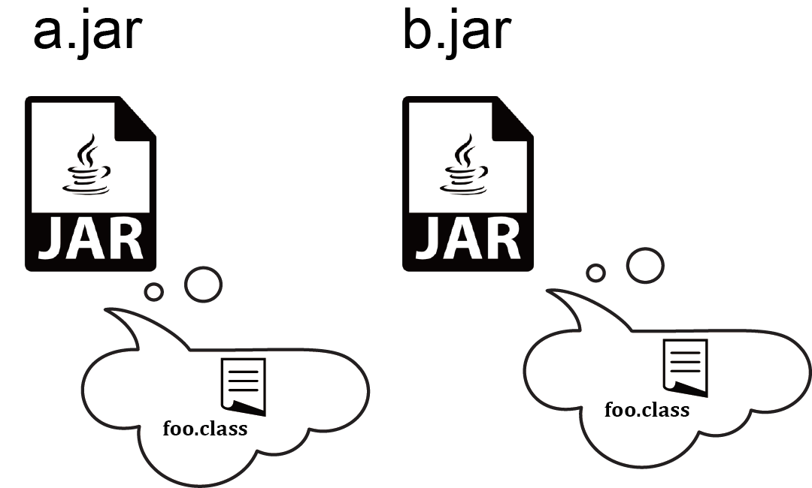
Example 1
foo.class
foo.class
java –cp a.jar; b.jar …

Slide 3





Example 2
lib1
lib2

Slide 4

Observations
2289
Popular Java projects
1457(64%)
Projects contain the same library of different versions
1003(44%)
Projects contain the duplicate classes in different libraries
954(42%)
Projects contain both conflicting classes and libraries

Slide 5
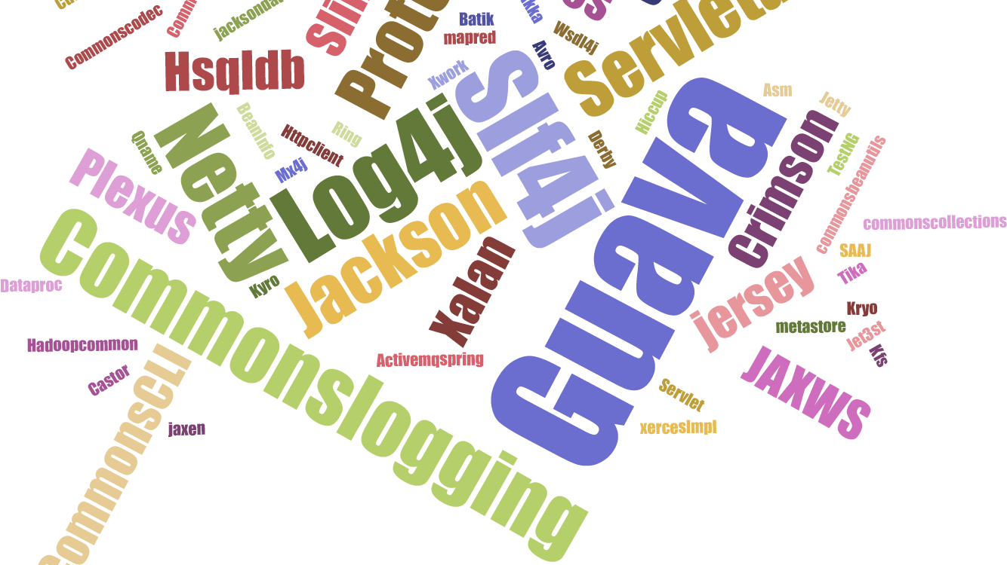
-4-

Slide 6
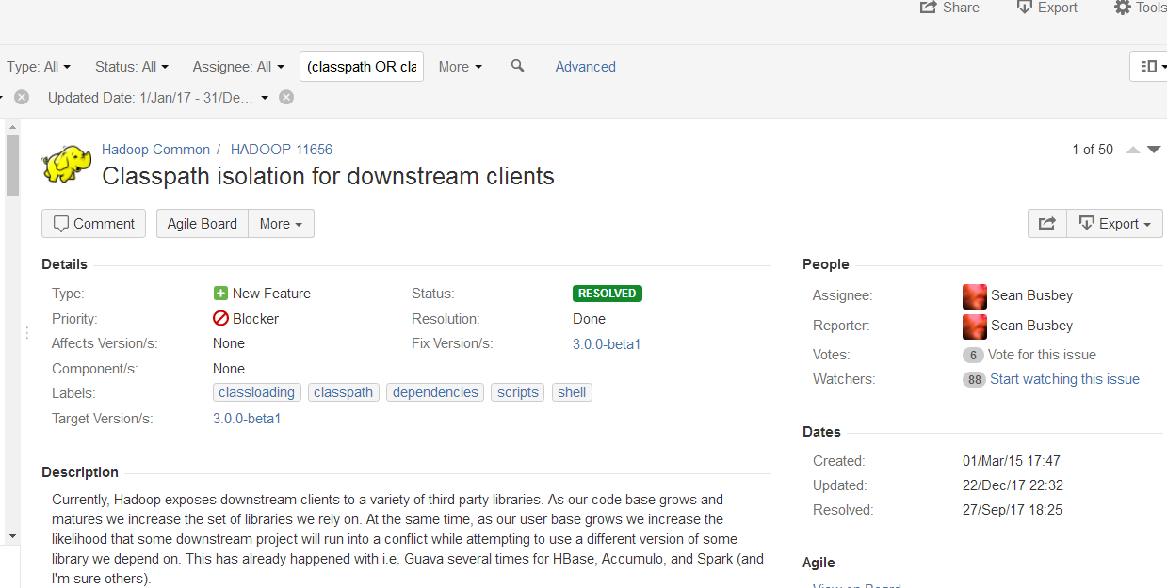
Example 3
176 downstream clients!
879 days!
Maven-shade-plugin

Slide 7

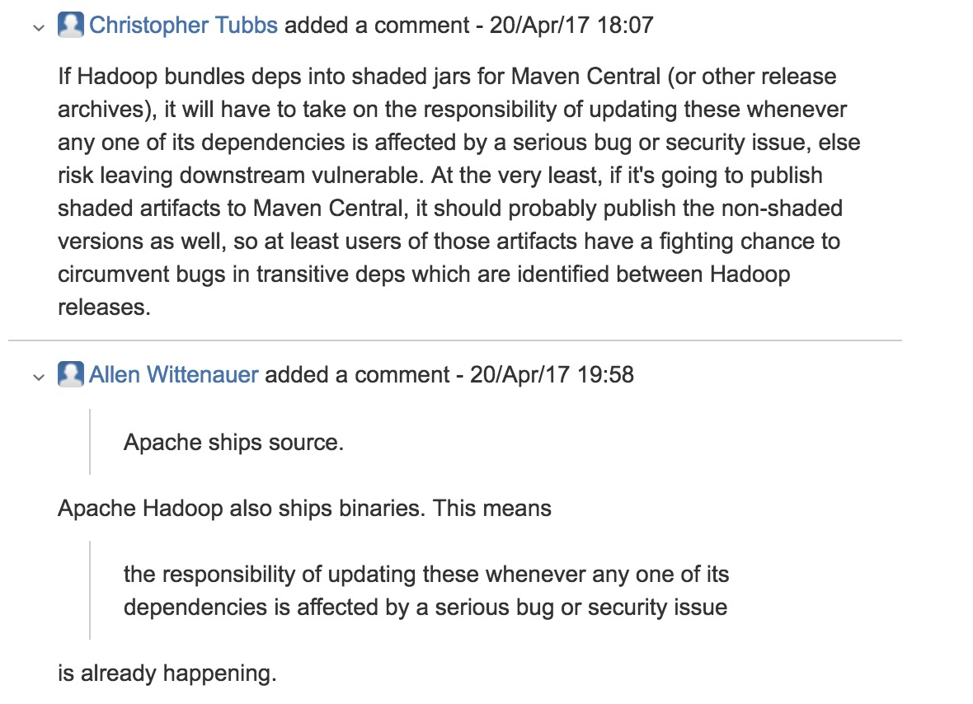
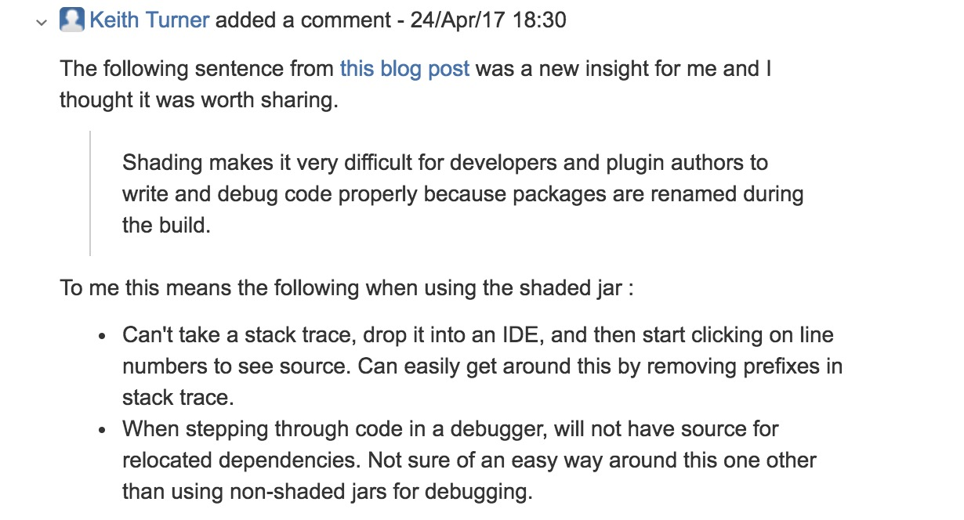
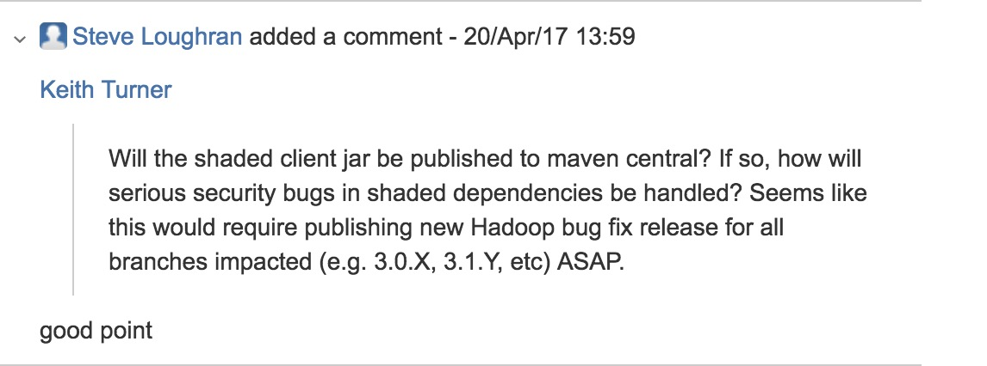

Slide 8
Motivation
Dependency Conflict (DC) problem is
very common in practice.
Building tools do not differentiate benign from harmful
(e.g., causing runtime exceptions) DC warnings.
Most building tools do not guarantee loading the most
appropriate class for the client project.
-6-

Slide 9

Our work
Empirical study
Empirical study
Manifestation
Patterns
Automated
diagnosis
Fixing Patterns
Empirical study
Detection
Assessing DC
severity levels
Evaluation
Empirical study
Effectiveness
Usefulness
-7-

Slide 10

Empirical study---Research questions
RQ1(Issue manifestation patterns):
What are the common manifestations of DC issues? Are there patterns that can be extracted to enable automated detection of these problems?
RQ2(Issue fixing patterns):
How do developers fix DC issues in practice? Are there factors that affect developers’ choices of different fixing solutions?
-8-

Slide 11




Empirical study---Data Collection
Java open source projects built by Maven from the Apache ecosystem are selected as the subjects for our empirical study, due to the following reasons:
Key words: 1) “library”, “dependency” or “compatibility”, etc.
2) “conflict” or “NoSuchMethodError”, etc.
135 DC issues (128 of them have been fixed)
-9-

Slide 12
Empirical study-RQ1: Issue manifestation patterns
A. Conflicts in library versions
C: 4%
B. Conflicts in classes among libraries
A: 29%
C. Conflicts in classes between
host project and libraries
B: 67%
-10-

Slide 13
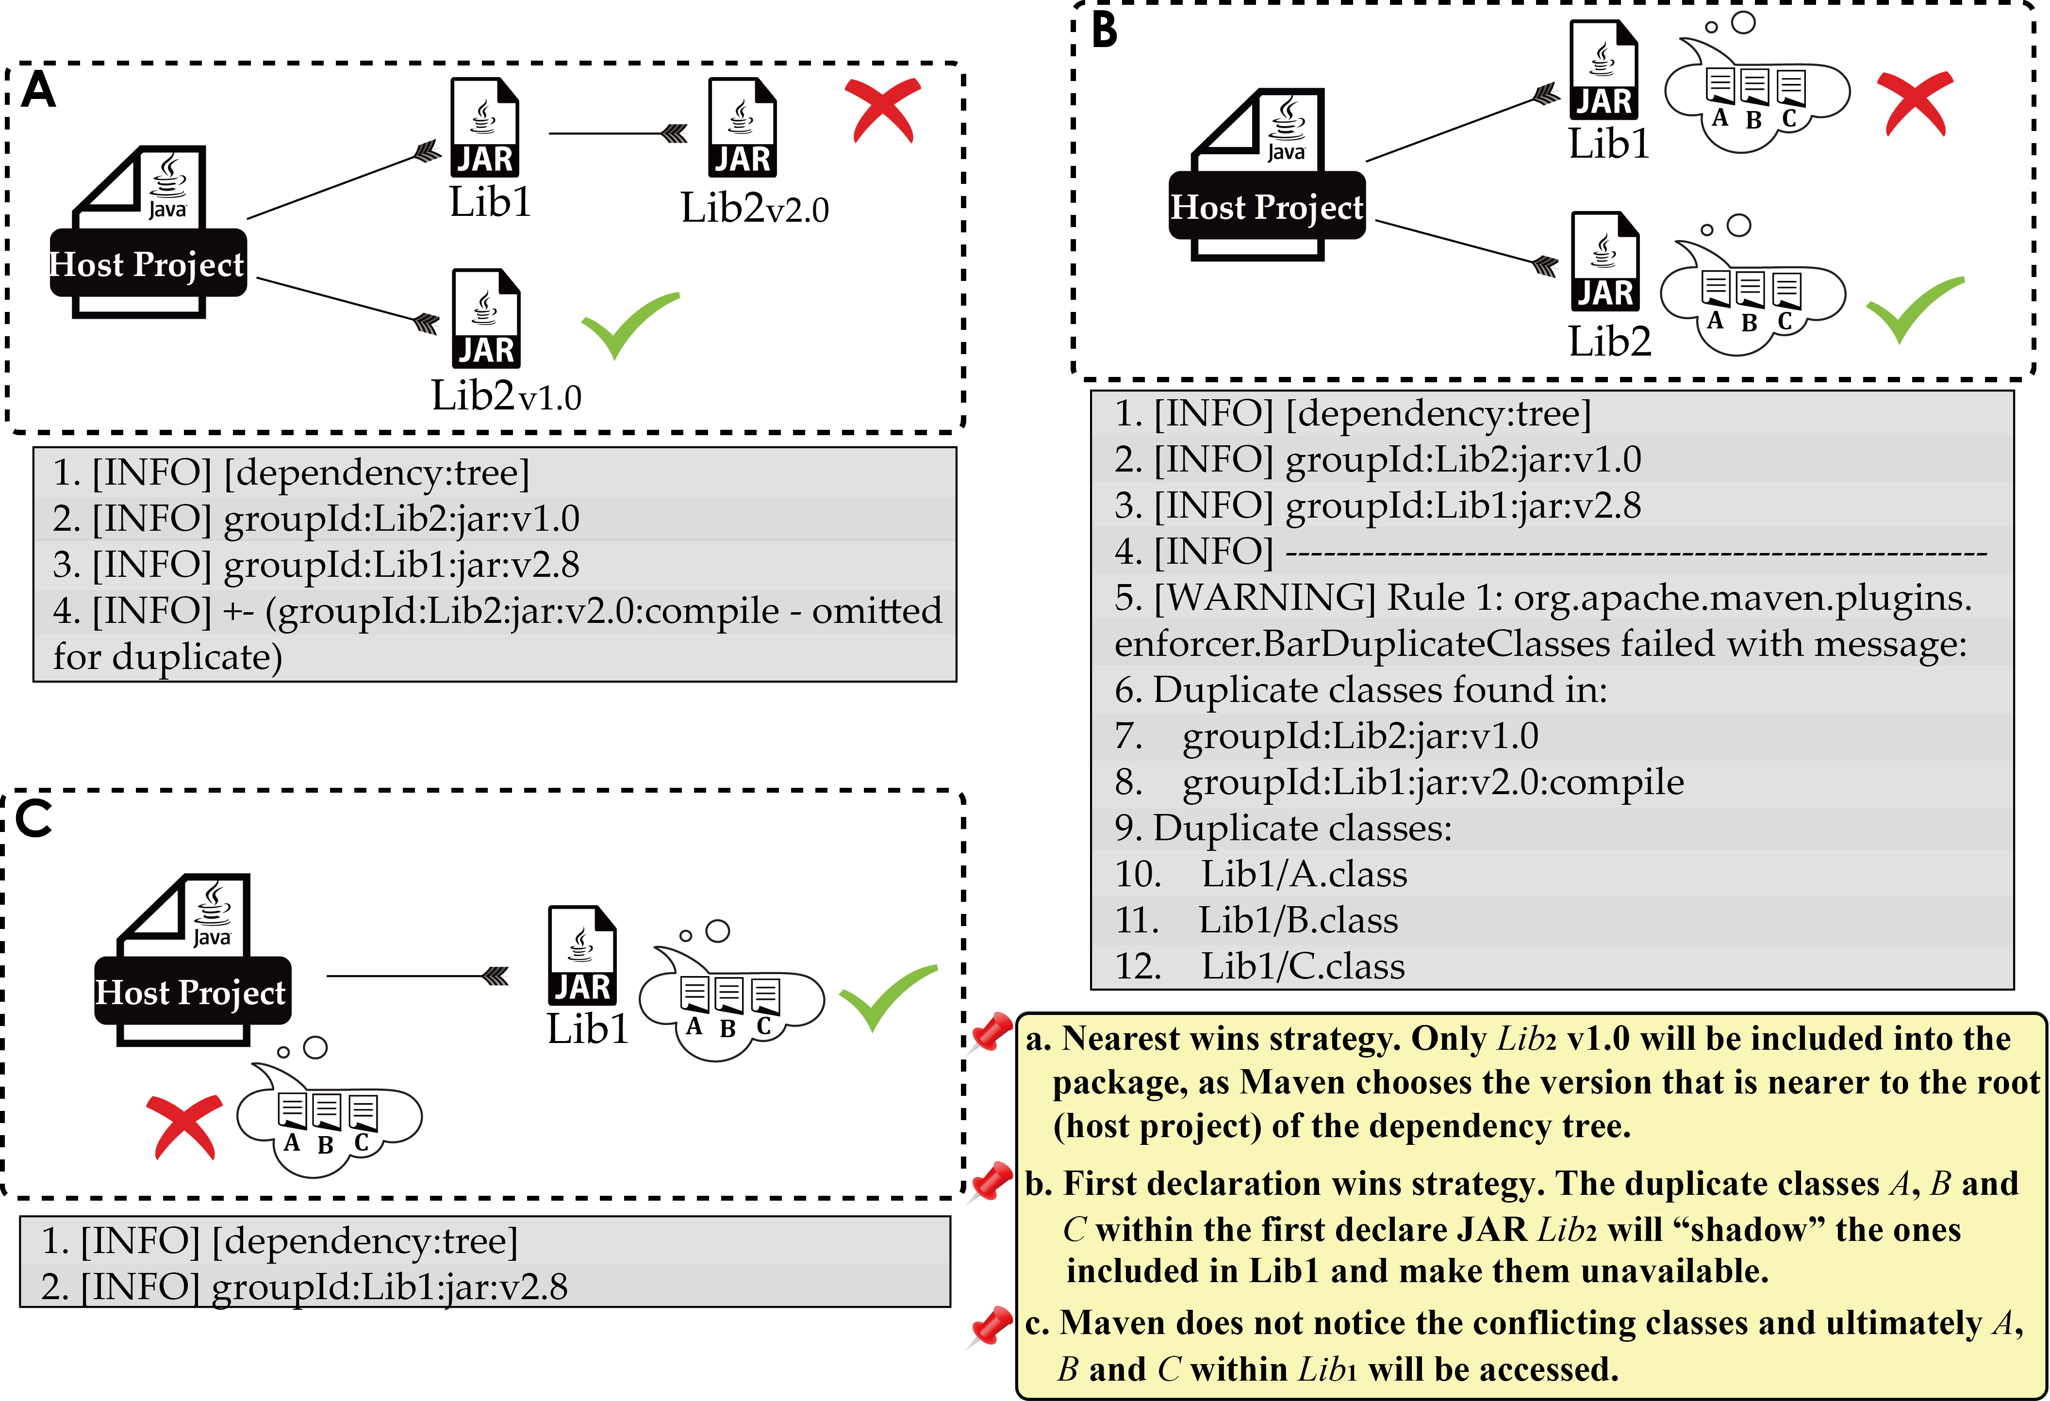
Empirical study-RQ1: Issue manifestation patterns
Conflicts in library versions
(39 out of 135 issues)
If there are multiple versions of the same library, according to Maven’s nearest wins strategy, Maven chooses the version that appears at the nearest to the root (host project) of the dependency tree.
If the host project references the features only defined in the shadowed library (i.e., Lib2v2.0), a runtime exception will occur.
NoClassDefFoundError
System Failure
NoSuchMethodError
-11-

Slide 14
Empirical study-RQ1: Issue manifestation patterns
B. Conflicts in classes among libraries
(90 out of 135 issues)
Based on the Maven’s first declaration wins strategy, the duplicate classes within the first declared library (i.e., lib2) will shadow the ones included in the others (lib1).
NoSuchMethodError
If the host project references the features only defined in the shadowed classes (i.e., class A, B, C in Lib1), a runtime exception will occur.
System Failure
-12-

Slide 15
Empirical study-RQ1: Issue manifestation patterns
C. Conflicts in classes between host project and libraries
(6 out of 135 issues)
If the host project and its referenced library (i.e., Lib1) include duplicate classes (i.e., A, B and C), then only those included in the library (i.e., Lib1) will be included during the packaging process.
NoSuchMethodError
The classes included in library Lib1 shadowed those defined in the host project, which leaded to a runtime failure.
System Failure
-13-

Slide 16
Empirical study-RQ1: Issue manifestation patterns
Loaded
Referenced
-14-

Slide 17






Empirical study-RQ2: Issue fixing patterns
Maven-Shade-Plugin provides the capability to package the project in an Uber Jar, including its third party libraries. It will also shade (i.e., rename) the packages of some of the libraries.
Pattern 1: Shading the conflicting libraries (25 out of 128 solutions)
Pattern 2: Adjusting the classpath order
of dependencies (42 out of 128 solutions)
Forcing a particular dependency order on the classpath is a strategy commonly used by developers for fixing DC issues at a relatively low cost.
#HDFS-10570
Hdfsproxy
Netty 2.0
HDFS
Hadoop
Netty 2.8
-15-

Slide 18
Empirical study-RQ2: Issue fixing patterns
Maven-Shade-Plugin provides the capability to package the project in an Uber Jar, including its third party libraries. It will also shade (i.e., rename) the packages of some of the libraries.
Pattern 1: Shading the conflicting libraries (25 out of 128 solutions)
Pattern 2: Adjusting the classpath order of dependencies (42 out of 128 solutions)
Forcing a particular dependency order on the classpath is a strategy commonly used by developers for fixing DC issues at a relatively low cost.
Pattern 3: Harmonizing library versions (51 out of 128 solutions)
Solutions of this pattern upgrade or downgrade some of the JARs to resolve the version inconsistencies.
-16-

Slide 19
Empirical study-RQ2: Issue fixing patterns
Maven-Shade-Plugin provides the capability to package the project in an Uber Jar, including its third party libraries. It will also shade (i.e., rename) the packages of some of the libraries.
Pattern 1: Shading the conflicting libraries (25 out of 128 solutions)
Pattern 2: Adjusting the classpath order of dependencies (42 out of 128 solutions)
Forcing a particular dependency order on the classpath is a strategy commonly used by developers for fixing DC issues at a relatively low cost.
Pattern 3: Harmonizing library versions (51 out of 128 solutions)
Solutions of this pattern upgrade or downgrade some of the JARs to resolve the version inconsistencies.
Pattern 4: Classloader customization
(5 out of 128 solutions)
This solution uses dynamic module system frameworks such as OSGI and Wildfly, to allow different versions of the same libraries or classes coexist in one project by creating multiple classloaders.
Pattern 5: Other workarounds
(5 out of 128 solutions)
The remaining issues are resolved in miscellaneous ways
-17-

Slide 20



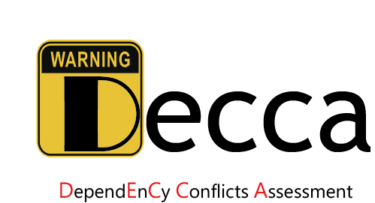
Dependency conflict diagnosis
Manifestaion
patterns
Detect dependency conflict issues
Maintenance efforts on fixing solutions
Assess their severity levels
-18-

Slide 21





Dependency conflict diagnosis
Library Dependency
Management Script
Binary Code File
1
2
Identify Duplicate Libraries or Classes
Extract library dependency tree
Lib2
Lib2
Lib3 v1.0
Lib2
Lib2
Lib3 v1.0
Lib4
Lib4
Lib3 v2.0
Lib5
Lib3 v2.0
Lib5
3
Analyze Relations Between Different Feature Set
Loaded
Shadowed
Referenced
4
Lib3 v2.0
Lib3 v1.0
L1
L2
L3
L4
-19-
Assessing Warning Severity Levels

Slide 22
Trial version of Decca
MODE 1
Level 1
Level 2
Level 3
Level 4
MODE 2
Level 1
Level 2
library
Shadowed
library
Host
Level 1
MODE 3
library
Shadowed
library
Host
Level 2
library
Shadowed
library
Level 3
Host

Slide 23
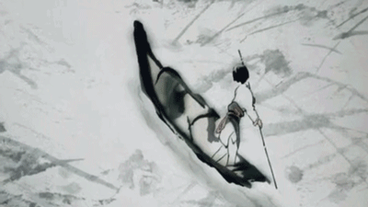
Thank you!
Notes:
Thank you for your attention.

